Slide 1
3D Computer Vision
Dr. Hassan Foroosh
School of EECS
UCF

Slide 2






Last Lecture
Homogeneous least-squares
Span and null-space
Closest rank r approximation
Pseudo inverse
Transformations
Point from Planes and Plane from points
(4x4-1=15 dof)

Slide 3
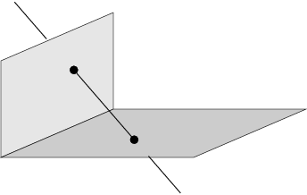
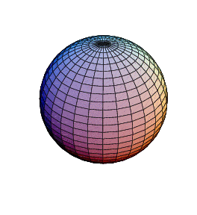
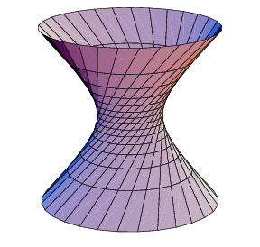
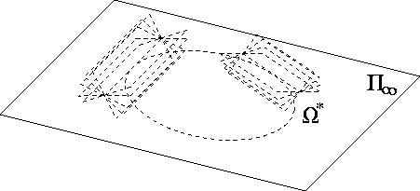
Today
Lines, and quadrics
П∞, ω∞ and Ω ∞

Slide 4
Lines in 3D Projective Space
(4dof)
Very awkward to represent
  4 degrees of freedom
  Need a 5-vector as opposed to points and planes that need 4-vectors
Different representations to tackle this problem
  Null-space & Span representation
  Plucker matrices

Slide 5
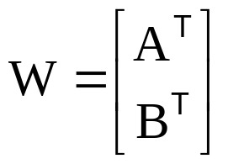

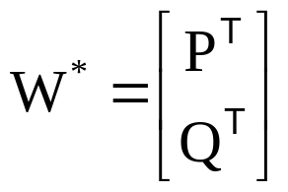

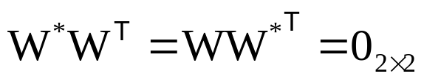
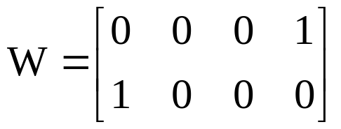
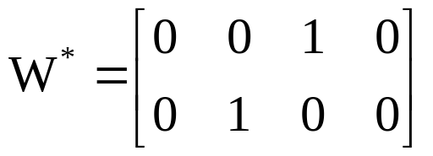
Null-space & Span Representation
The span of W^{T} is the pencil of points on the line
Null space of W is the pencil of planes
The span of W^{*T} is the pencil of planes
Null space of W* is the pencil of points on the line
Relationship:
Example: X-axis

Slide 6

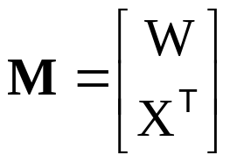



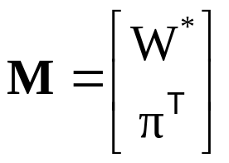


Points, lines and planes
Join and incidence relations

Slide 7


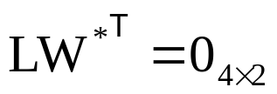


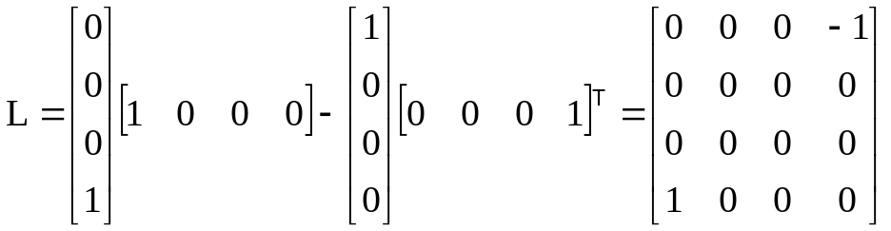
Plücker Representation
Plücker matrix (4x4 skew-symmetric homogeneous matrix)
L has rank 2
4dof
generalization of
L independent of choice A and B
Transformation
Example: x-axis
Notes:
A,B on line AW*=0, BW*=0, …
4dof, skew symmetric 6dof, scale -1, rank2 -1
Prove independence of choice by filling in C=A+muB, AA-AA disappears, …
Prove transform based on A’=HA, B’=HB,…

Slide 8







Plücker Representation
Dual Plücker matrix L*
Correspondence
Join and incidence
(plane through point and line)
(point on line)
(intersection point of plane and line)
(line in plane)
(coplanar lines)
Notes:
Indicate 12-34 {1234} always present
Prove join (AB’+BA’)P=A (if A’P=0) which is general since L independent of A and B
Example intersection X-axis with X=1: X=counterdiag(-1 0 0 1)(1 0 0 -1)’=(1 0 0 1)’

Slide 9
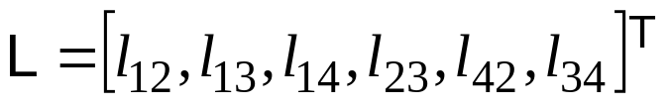
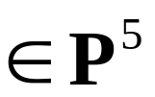


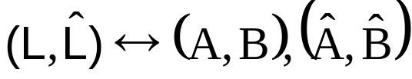
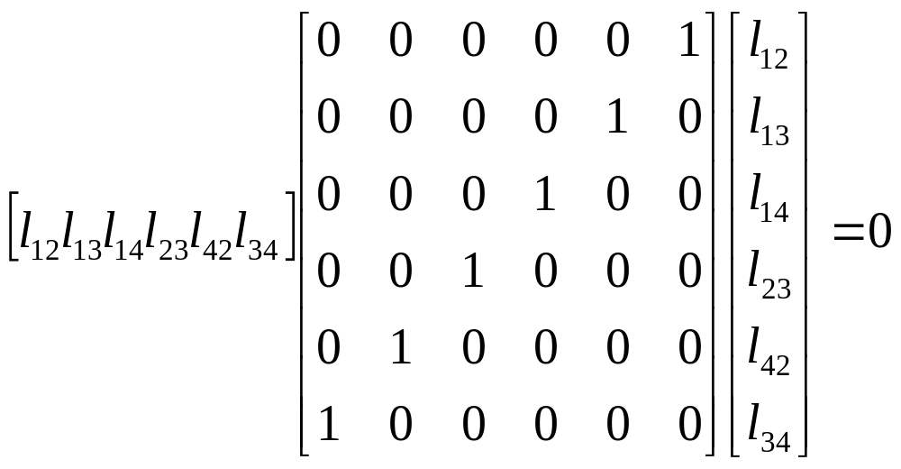
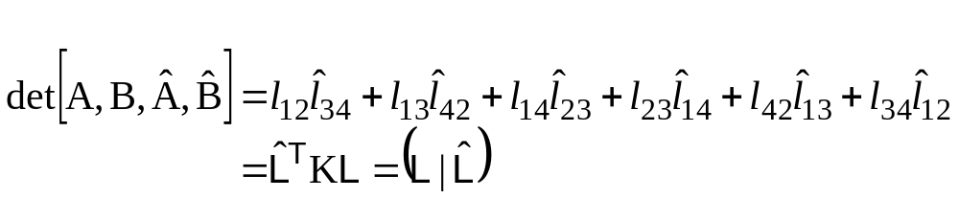
Plücker line coordinates
on Klein quadric
Notes:
L consists of non-zero elements

Slide 10

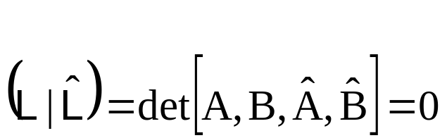
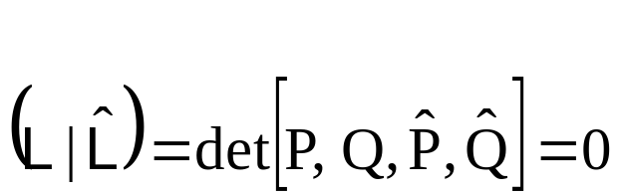
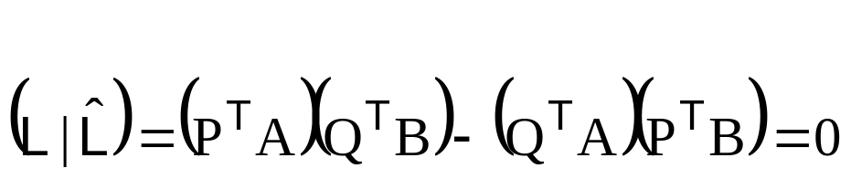
Plücker line coordinates
(Plücker internal constraint)
(two lines intersect)
(two lines intersect)
(two lines intersect)

Slide 11

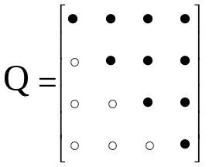







Quadrics and dual quadrics
(Q : 4x4 symmetric matrix)
9 d.o.f.
in general 9 points define quadric
det Q=0 ↔ degenerate quadric
pole – polar
(plane ∩ quadric)=conic
transformation
relation to quadric (non-degenerate)
transformation
Notes:
3. and thus defined by less points
4. On quadric=> tangent, outside quadric=> plane through tangent point
5. Derive X’QX=x’M’QMx=0

Slide 12
Quadric classification
Rank | Sign. | Diagonal | Equation | Realization
4 | 4 | (1,1,1,1) | X²+ Y²+ Z²+1=0 | No real points
 | 2 | (1,1,1,-1) | X²+ Y²+ Z²=1 | Sphere
 | 0 | (1,1,-1,-1) | X²+ Y²= Z²+1 | Hyperboloid (1S)
3 | 3 | (1,1,1,0) | X²+ Y²+ Z²=0 | Single point
 | 1 | (1,1,-1,0) | X²+ Y²= Z² | Cone
2 | 2 | (1,1,0,0) | X²+ Y²= 0 | Single line
 | 0 | (1,-1,0,0) | X²= Y² | Two planes
1 | 1 | (1,0,0,0) | X²=0 | Single plane
Notes:
Signature sigma= sum of diagonal,e.g. +1+1+1-1=2,always more + than -, so always positive…

Slide 13
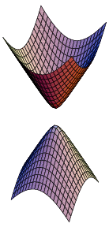
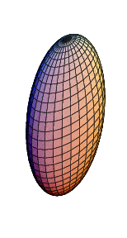
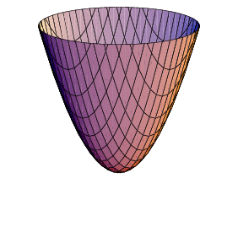
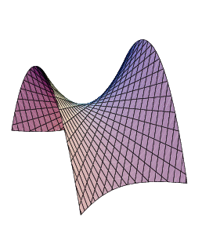
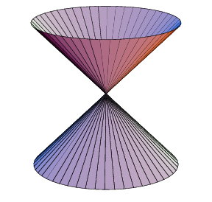
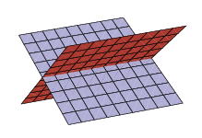
Quadric classification
Projectively equivalent to sphere:
sphere
ellipsoid
hyperboloid of two sheets
paraboloid
Ruled quadrics:
hyperboloids of one sheet
Degenerate ruled quadrics:
cone
two planes
Notes:
Ruled quadric: two family of lines, called generators.
Hyperboloid of 1 sheet topologically equivalent to torus!

Slide 14
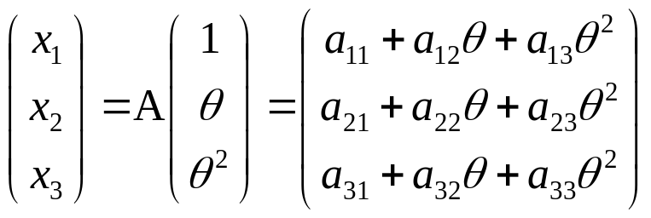
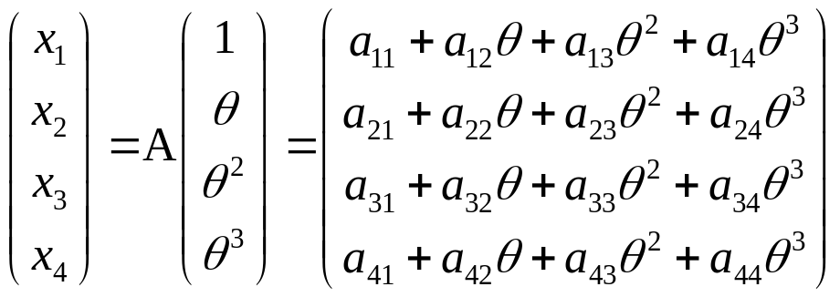
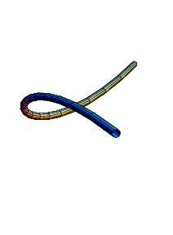
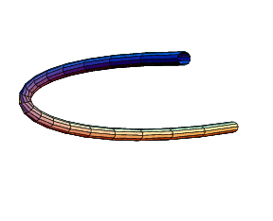
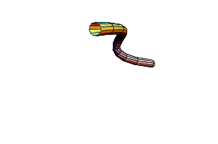
Twisted cubic
twisted cubic
conic
3 intersection with plane (in general)
12 dof (15 for A – 3 for reparametrisation (1 θ θ²θ³)
2 constraints per point on cubic, defined by 6 points
projectively equivalent to (1 θ θ²θ³)
Horopter & degenerate case for reconstruction

Slide 15
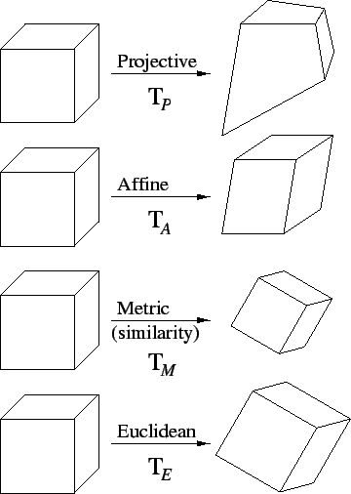
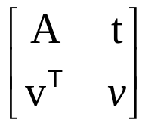
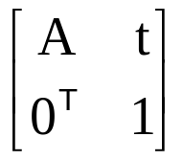
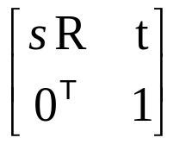
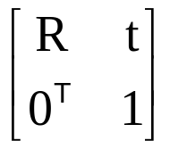
Hierarchy of transformations
Projective
15dof
Intersection and tangency
Parallellism of planes,
Volume ratios, centroids,
The plane at infinity π∞
Affine
12dof
Similarity
7dof
The absolute conic Ω∞
Euclidean
6dof
Volume

Slide 16
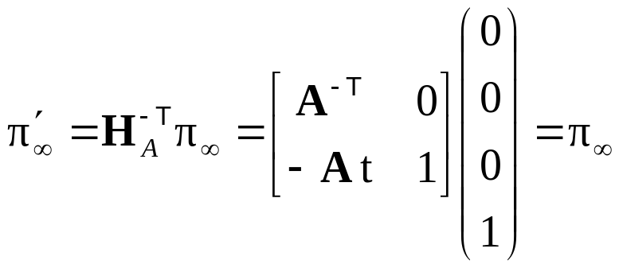


The plane at infinity
The plane at infinity π∞ is a fixed plane under a projective transformation H iff H is an affinity
canical position
contains directions
two planes are parallel ⇔ line of intersection in π∞
line // line (or plane) ⇔ point of intersection in π∞
Notes:
Represents 3DOF between projective and affine

Slide 17
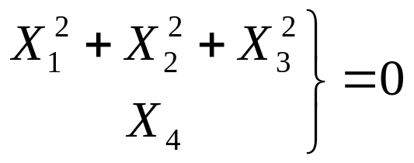
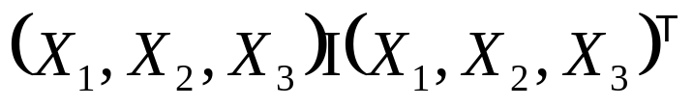
The absolute conic
The absolute conic Ω∞ is a (point) conic on π∞.
In a metric frame:
or conic for directions:
(with no real points)
The absolute conic Ω∞ is a fixed conic under the projective transformation H iff H is a similarity
Ω∞ is only fixed as a set
Circle intersect Ω∞ in two points
Spheres intersect π∞ in Ω∞
Notes:
Represent 5 DOF between affine and similarity

Slide 18
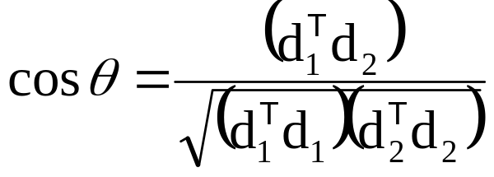
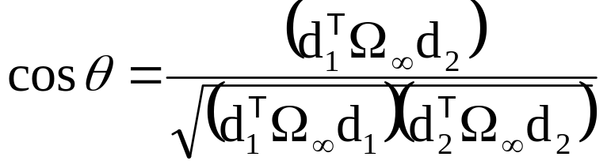
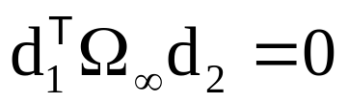
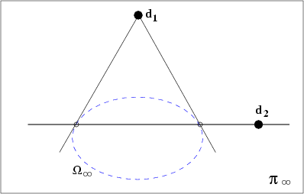
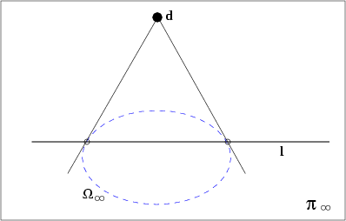
The absolute conic
Euclidean:
Projective:
(orthogonality=conjugacy)
normal
plane
Notes:
Orthogonality is conjugacy with respect to Absolute Conic

Slide 19
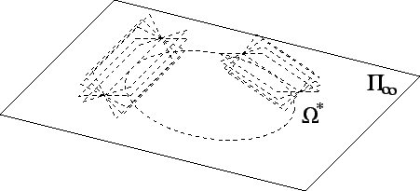
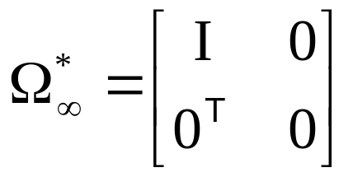
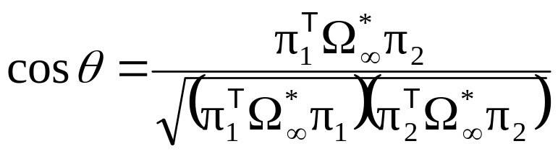
The absolute dual quadric
The absolute conic Ω*∞ is a fixed conic under the projective transformation H iff H is a similarity
8 dof
plane at infinity π∞ is the nullvector of Ω∞
Angles:

Slide 20
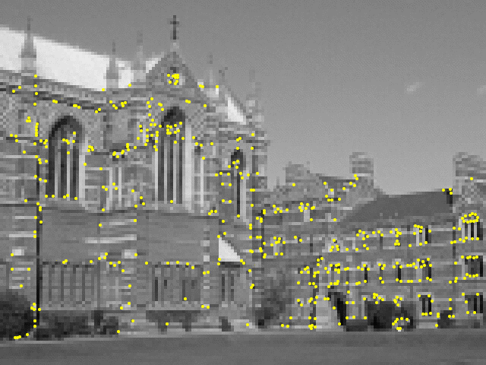





Next classes:Parameter estimation
Direct Linear Transform
Iterative Estimation
Maximum Likelihood Est.
Robust Estimation

